Slide 1


S.T.A.T.I.C
“Stable Transportation And Technology In Cities”
Team: Jing Bao, Alvin La, Dongrui Lu, Kevin Yan
Advisor: Dr. Biruk A. Gebre
ME-423 B

Slide 2
Outline
Project Description
Motivation, Goals, Objectives
Potential and Current Issues
Literature Review
State of the Art Analysis and Commercial Applications
Customer Needs and Specifications
Concept Generation
Concept Combination and Concept Metrics
Concept Selection
Technical Analysis
Project Plan
Deliverables, Schedule, and Budget
Conclusion

Slide 3


Description
Goals and Objectives
Designing a safe and stable personal-urban-transportation vehicle
Satisfy various customer needs
Constructed and tested an alpha prototype by the Senior Innovation Expo in May 2021
Motivation
Growing market needs in urban
environments
Increasingly popular method
Environmental-friendly

Slide 4

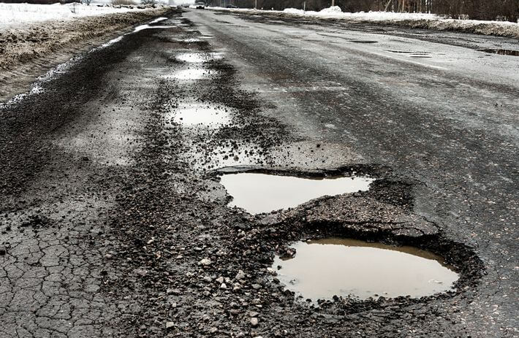
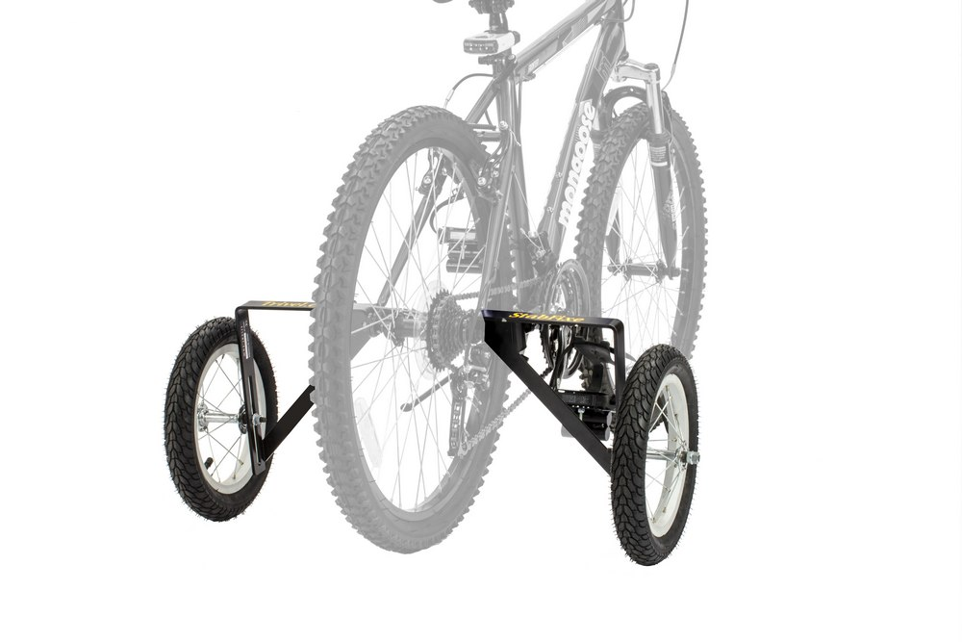
Potential and Current Issues
Design and Analysis Issues
Urban environment
Uneven terrain (potholes, curbs, and speed bumps)
Portability
Weather conditions(water-proofing, corrosion resistance)
Issues in automotive design
Primary stakeholder: adults ages 30 and over
Static stability
Trade-offs between incorporating Automotive features
More than two wheels, more weight
Material selection

Slide 5
Potential and Current Issues
Design and Analysis Issues
Urban environment
Uneven terrain (potholes, curbs, and speed bumps)
Portability
Weather conditions(water-proofing, corrosion resistance)
Issues in automotive design
Primary stakeholder: adults ages 30 and over
Static stability
More than two wheels, more weight
Material selection
Trade-offs between incorporating Automotive features

Slide 6

Potential and Current Issues
Prototyping and Experimentation Issues
COVID-19 influence
Team members unable to meet physically and work hands on
Unable to use the machine shops and 3D-printing labs on campus
May be difficult to order and receive design parts on time
Creation Virtual alpha-prototype

Slide 7
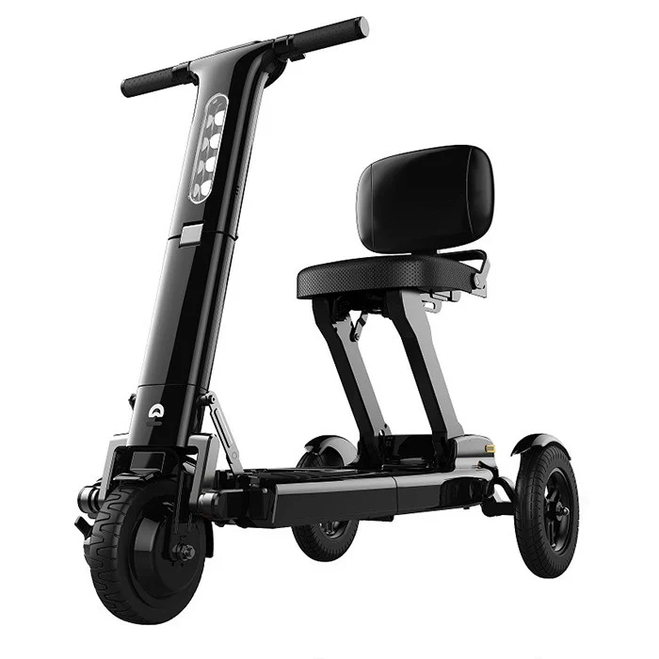
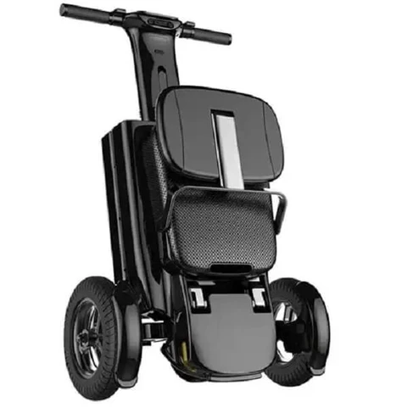
State-of-the-Art
Relync R1
Pros
Tripedal
Collapsable when not in use(With Portability Functionality)
Cons
Top Speed=8 MPH
Price = $3300
Optimized for Indoor and Pedestrian Use

Slide 8
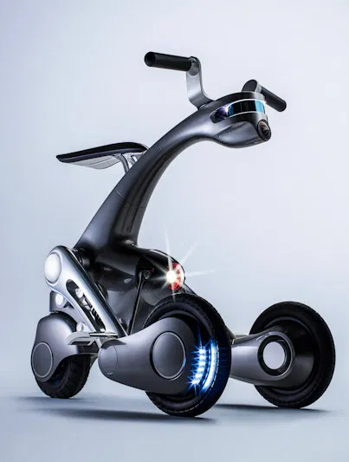
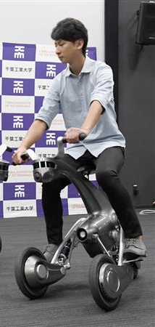
State-of-the-Art
fuRo canguRo
Pros
Tripedal
Lidar Mapping(AI/Safety feature)
Dual-Monoshock Suspension
Compact Form-Factor
Cons
Top Speed=6 MPH
Weight=141 lbs

Slide 9
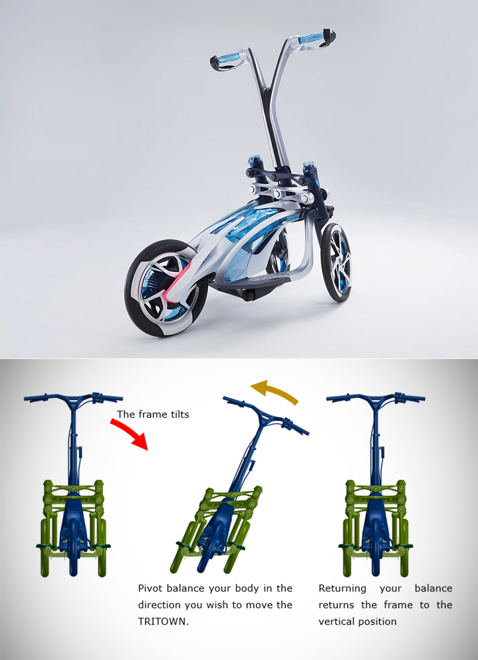
State-of-the-Art
YAMAHA TRITOWN
Pros
Tripedal
Frame Adjusts with Lean
↑ Handling by ↓ Turn Radius
Top Speed=15 MPH
Cruising Range=20 Mi
Cons
Weight=88.2 lbs
Non-Collapsible
Notes:
First introduce State of the Art: “Analysis of the current products on the market”
“I will state a few pros and cons of the model”
“These products will prove a basis of understanding and ideas for concept generation”

Slide 10
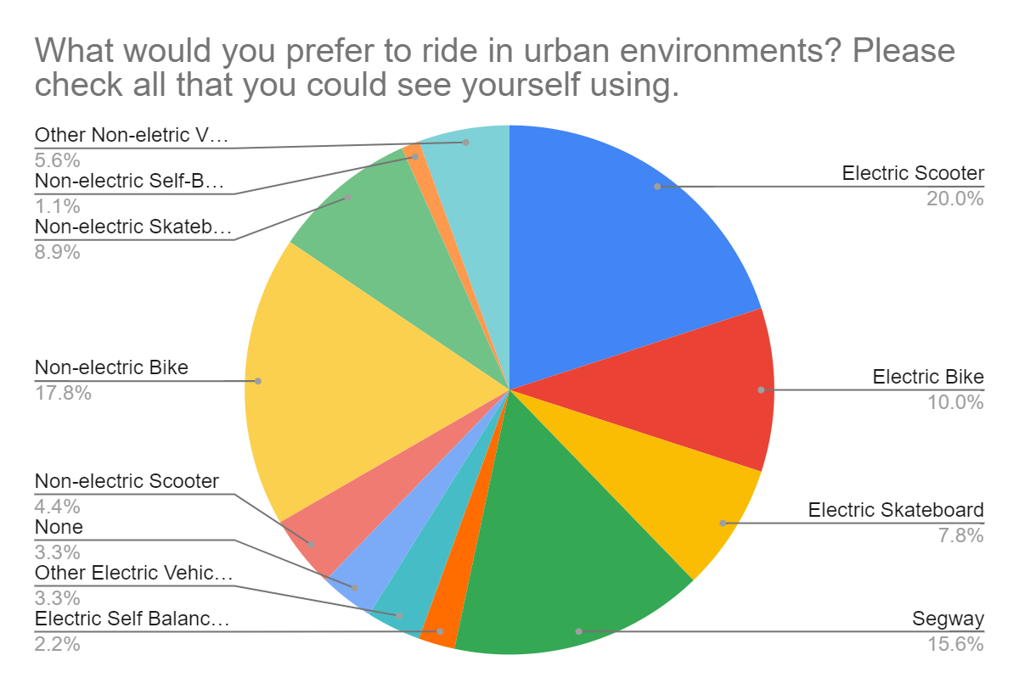
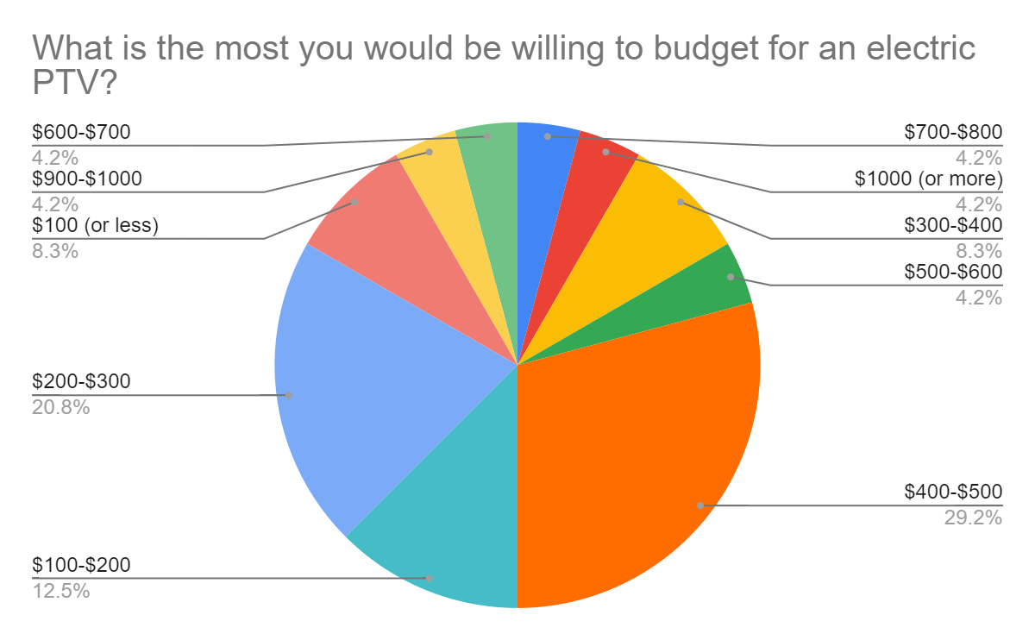
Customer Information
Target Customer: Everyday City Commuter, Hobbyist/Recreational Use Consumer
Other Stakeholders: Department of Transportation, Regular Passerbys
Gathering Information
Online Survey: 24 responses
In-depth Interviews: 15 contacts

Slide 11

Customer Needs and Specifications
Needs
Safe
Stable during rides
Has a long battery life
Controls ride speed effectively
Easily portable to carry around
Specifications
Maximum Obstacle Traversal Height
Support Polygon Area
Maximum Run Time
Max speed, acceleration
Minimum Collapsible Size

Slide 12

Concept Generation
Developed 11 total concepts based on customer needs:
7 Initial Concepts
4 Combination Concepts
Concept generations were either handsketched or modeled using CAD software (Solidworks)
Began figuring out concept metrics to further concept generation understanding
Max Speed limit (universal 25 mph)
Turn Radius (differs among concepts)
Storing Capability (volume)
etc.

Slide 13

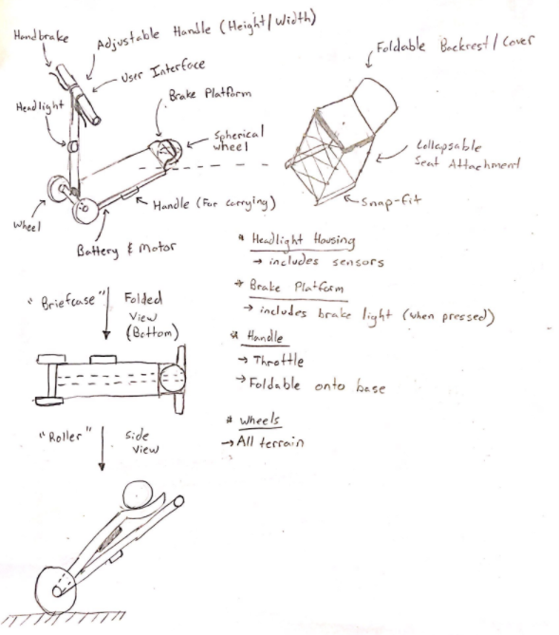
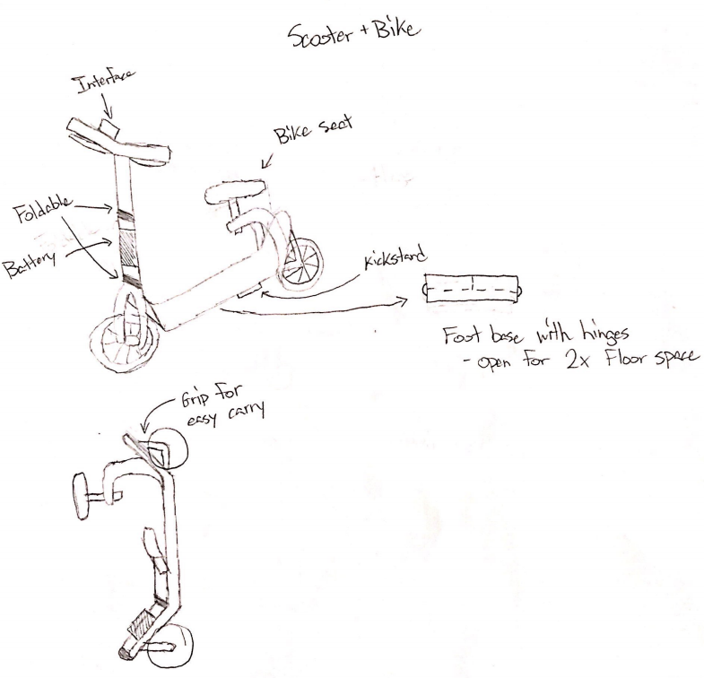
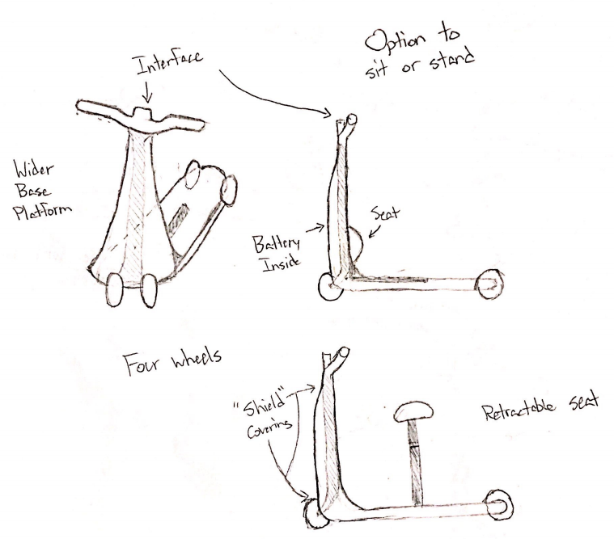
Initial Concepts
Concept 1
Key Features:
Seated
2 Wheels
Expandable Deck
Foldable
Concept 2
Key Features:
Seated / Standing
3 Wheels
Shield
Foldable
Concept 3
Key Features:
Seated / Standing
3 Wheels
Foldable

Slide 14
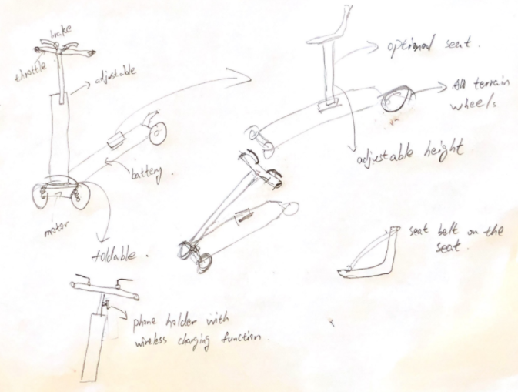
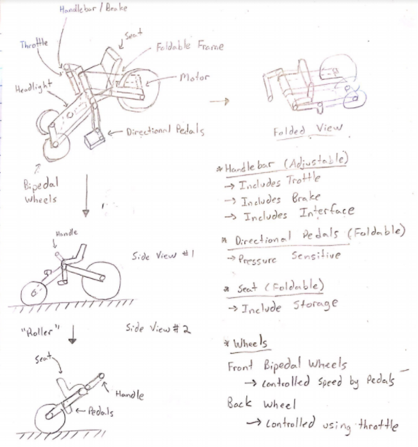
Initial Concepts
Concept 5
Key Features:
Seated / Standing
3 Wheels
Foldable
Charge Port
Concept 4
Key Features:
Seated
3 Wheels
Foldable
Lean Steering

Slide 15
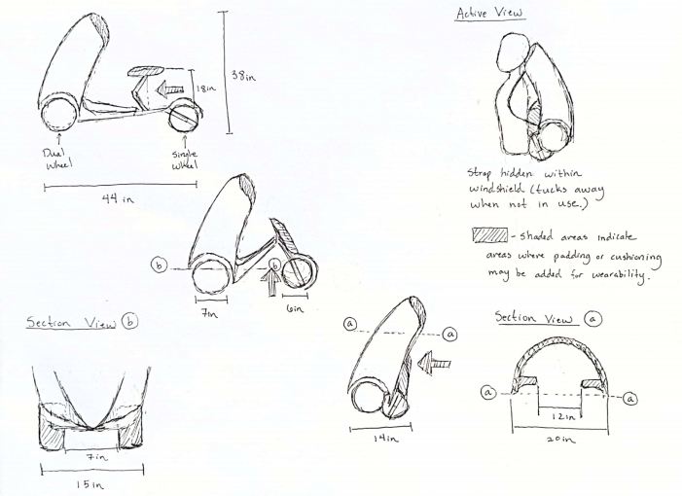
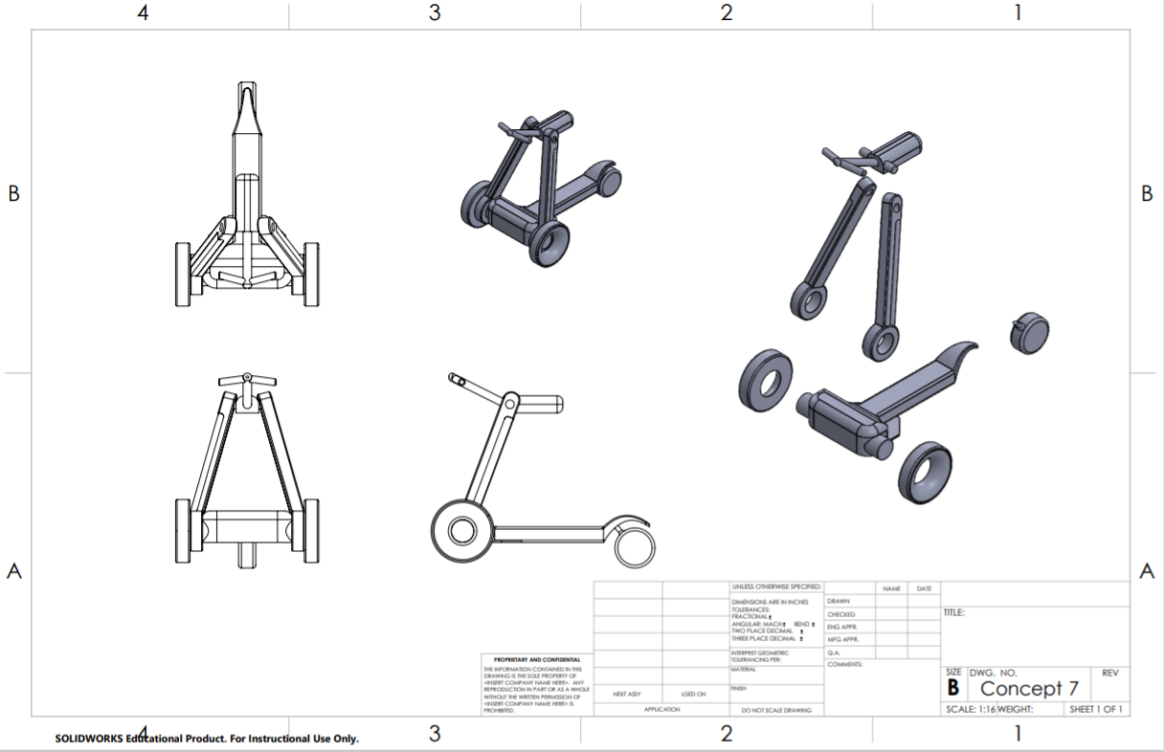
Initial Concepts
Concept 6
Key Features:
Seated
3 Wheels
Foldable
Wearable
Shield
Concept 7
Key Features:
Seated
3 Wheels
Foldable

Slide 16
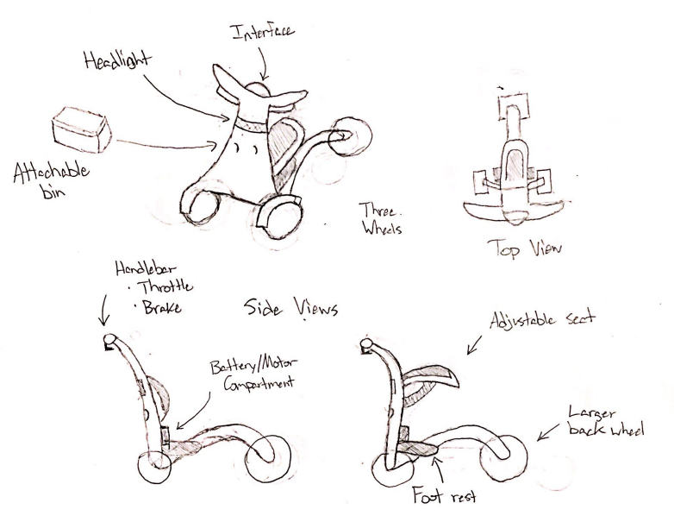
Combination Concepts
Concept 8 (Shield Vehicle)
Key Features:
Seated / Standing
3 Wheels
Additional Storage
Shield
Concept 2 & 7

Slide 17
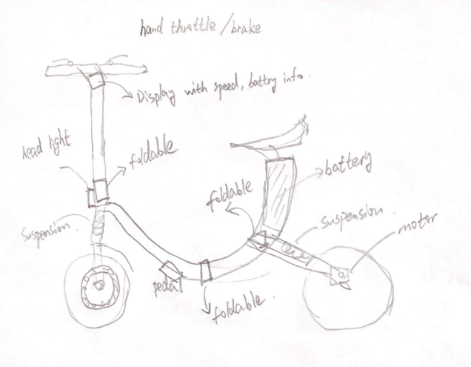
Combination Concepts
Concept 9 (Sitting Scooter)
Key Features:
Seated
2 Wheels
Foldable
Concept 1 & 5

Slide 18
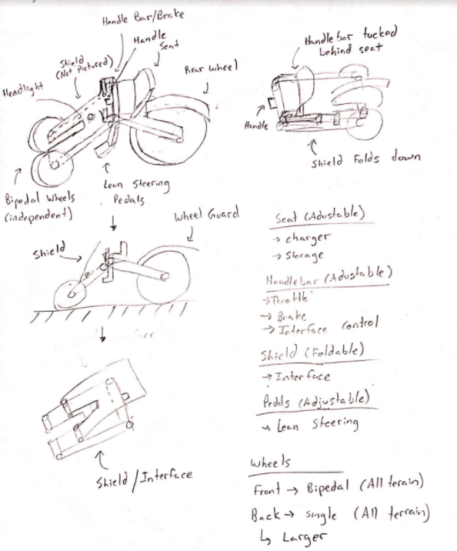
Combination Concepts
Concept 10 (Leaning Tri-Wheel)
Key Features:
Seated
3 Wheels
Foldable
Lean Steering
Shield
Concept 2 & 4

Slide 19
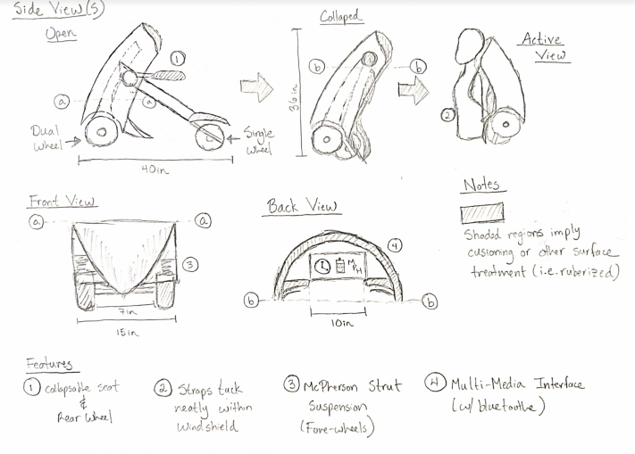
Combination Concepts
Concept 11 (Backpack Vehicle)
Key Features:
Seated
3 Wheels
Foldable
Wearable
Shield
Concept 6 & 7

Slide 20

Concept Selection
Utilize customer needs and metrics to score individual concepts
Stage 1: Rate initial concepts (7 total)
“Plus-Zero-Minus” Decision Matrix
Stage 2: Rate combination concepts (4 total)
“Plus-Zero-Minus” Decision Matrix
Stage 3: Final ratings for combination concepts
“Weighted Ranking” Scoring Matrix
Stage 4: Rank concepts
Choose top ranked concept(s)
Multiple concepts chosen if selection margin is close

Slide 21
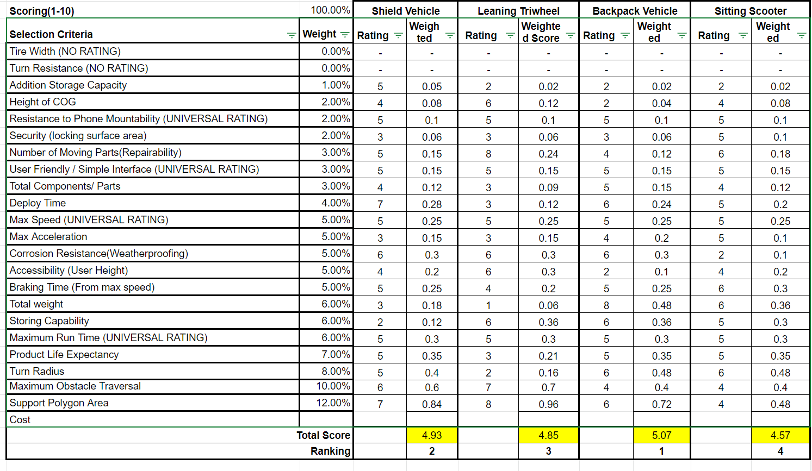
Concept Selection (Stages 1 - 4)
Final Concept Ranking
Backpack Vehicle
5.07
Shield Vehicle
4.93
Leaning Tri-Wheel*
4.85

Slide 22
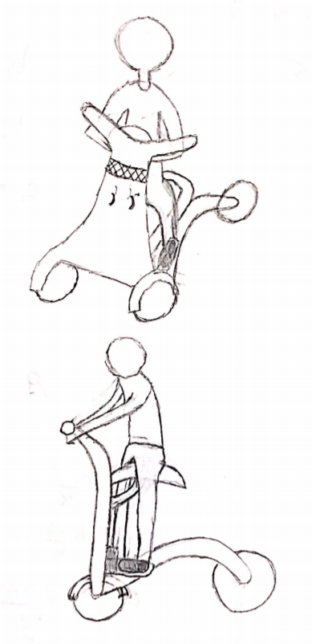
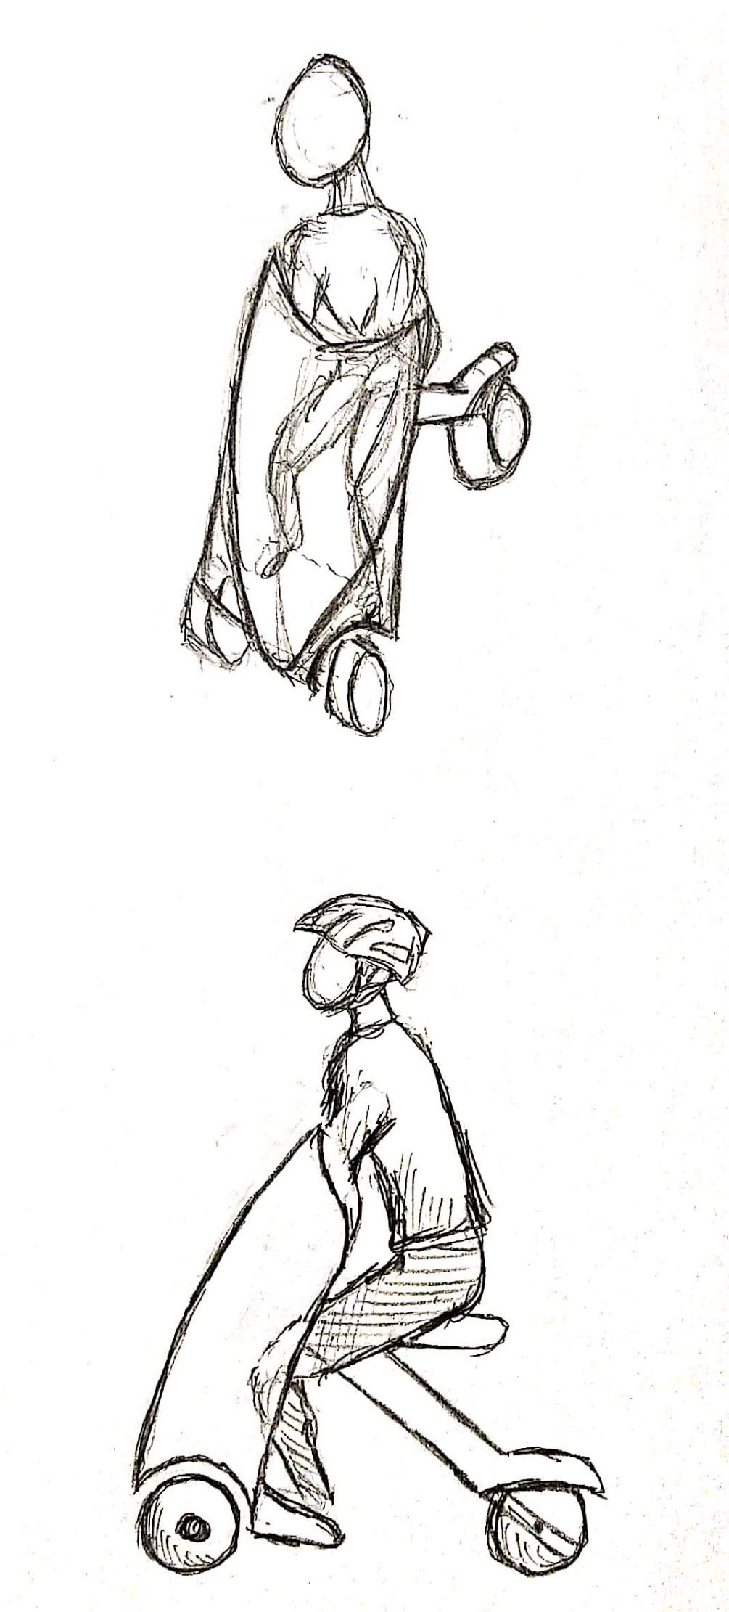
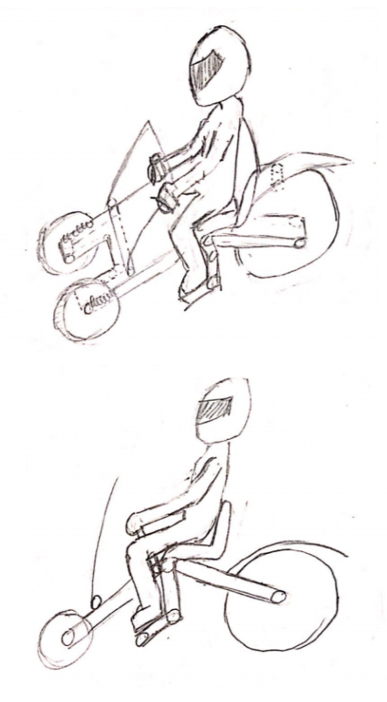
Concept Selection
Shield Vehicle
Rank: 2
Backpack Vehicle
Rank: 1
Leaning Tri-Wheel
Rank: 3

Slide 23

Technical Analysis
Automotive Subsystems
Suspension System
Monoshock
Critical Damping Areas
Braking System
Disk vs Hydraulic vs Rim/Caliper
Braking Efficiency
Steering System
Turn Radius
Counter Steer vs Bar Steer
Vehicle Dynamics
Drivetrain
AWD; FWD; RWD
Slope Angle
Maximum Obstacle Traversal
Dependant on Drivetrain
Static Stability
Support Polygon
Contact Points

Slide 24
Technical Analysis
Automotive Subsystems
Suspension System
Monoshock
Critical Damping Areas
Braking System
Disk vs Hydraulic vs Rim/Caliper
Braking Efficiency
Steering System
Turn Radius
Counter Steer vs Bar Steer
Vehicle Dynamics
Drivetrain
AWD; FWD; RWD
Slope Angle
Maximum Obstacle Traversal
Dependant on Drivetrain
Static Stability
Support Polygon
Contact Points

Slide 25


Project Plan - Deliverables
Phase 1
Define Project Objectives
State-of-the-Art Review
Customer Needs and Specifications
Concept Generation
Concept Selection
Preliminary Technical Analysis
Report and Presentation
Phase 2
Technical Analysis
Concept CAD Models
Presentation and Initial Project Website
Phase 3
Engineering Design
Alpha Prototype
Report and Presentation

Slide 26
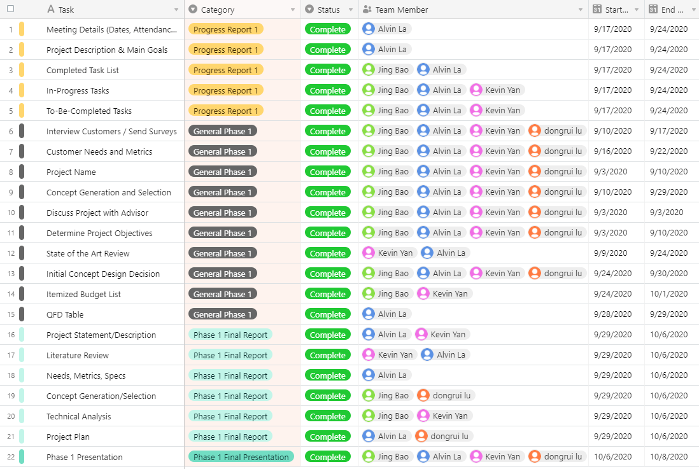
Project Plan - Schedule

Slide 27
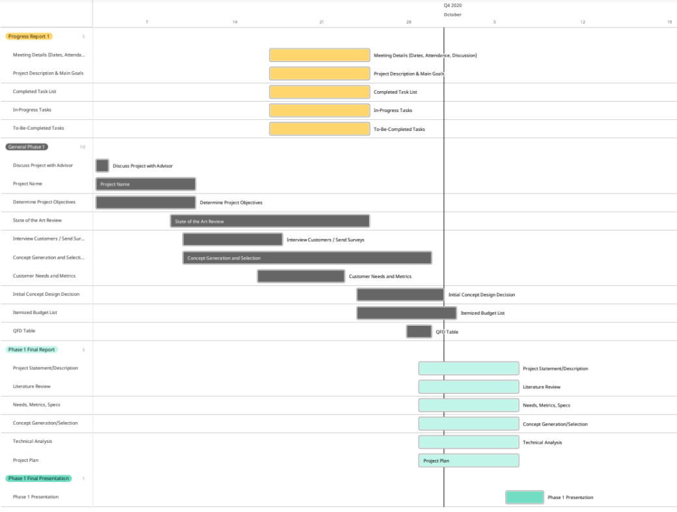
Project Plan - Schedule

Slide 28
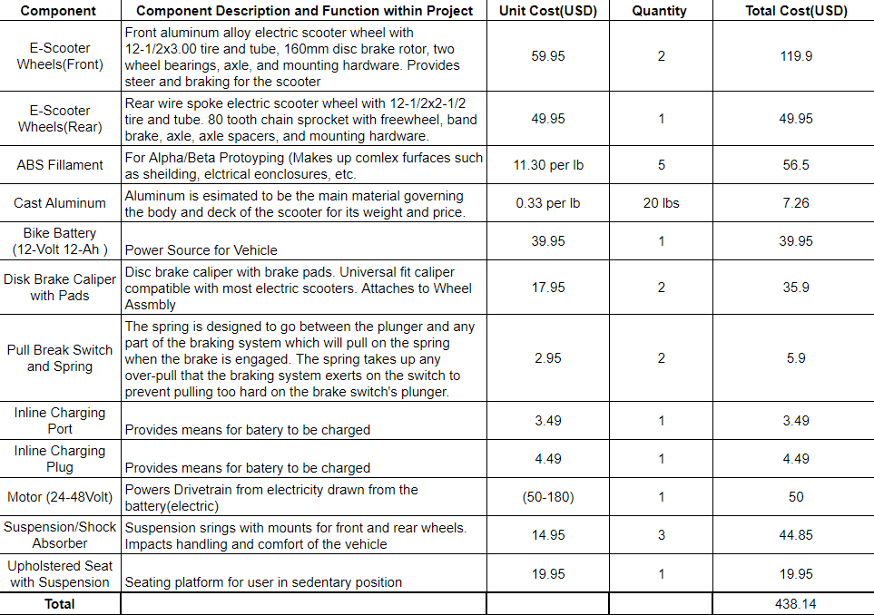
Project Plan - Budget

Slide 29


Conclusion
Project is on track with the original goals
and milestones:
Statically Stable
Safe
Portable
Customer Needs and Metrics are
understood
Final concepts are ready to be
optimized
Technical Analysis Systems
Used in final concept generation
Budget
Final parts list will be developed to ensure a successful building phase

Slide 30
Questions?

Slide 31
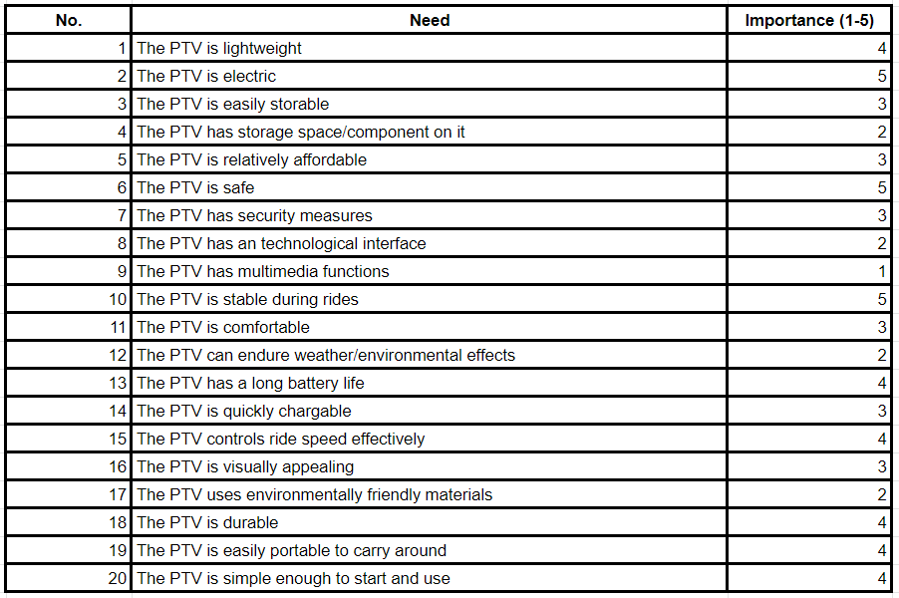
Customer Needs List

Slide 32
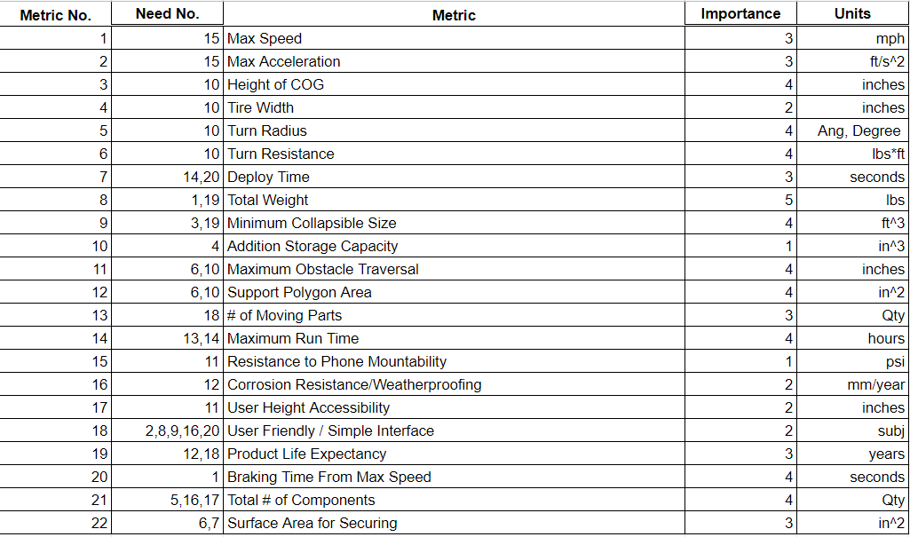
Customer Metrics List

Slide 33
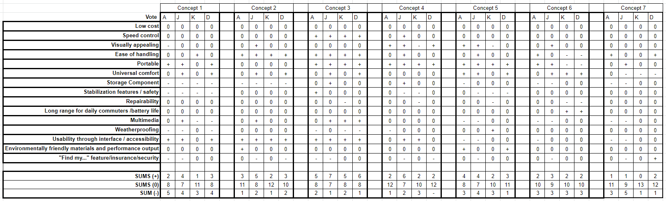
Stage 1

Slide 34
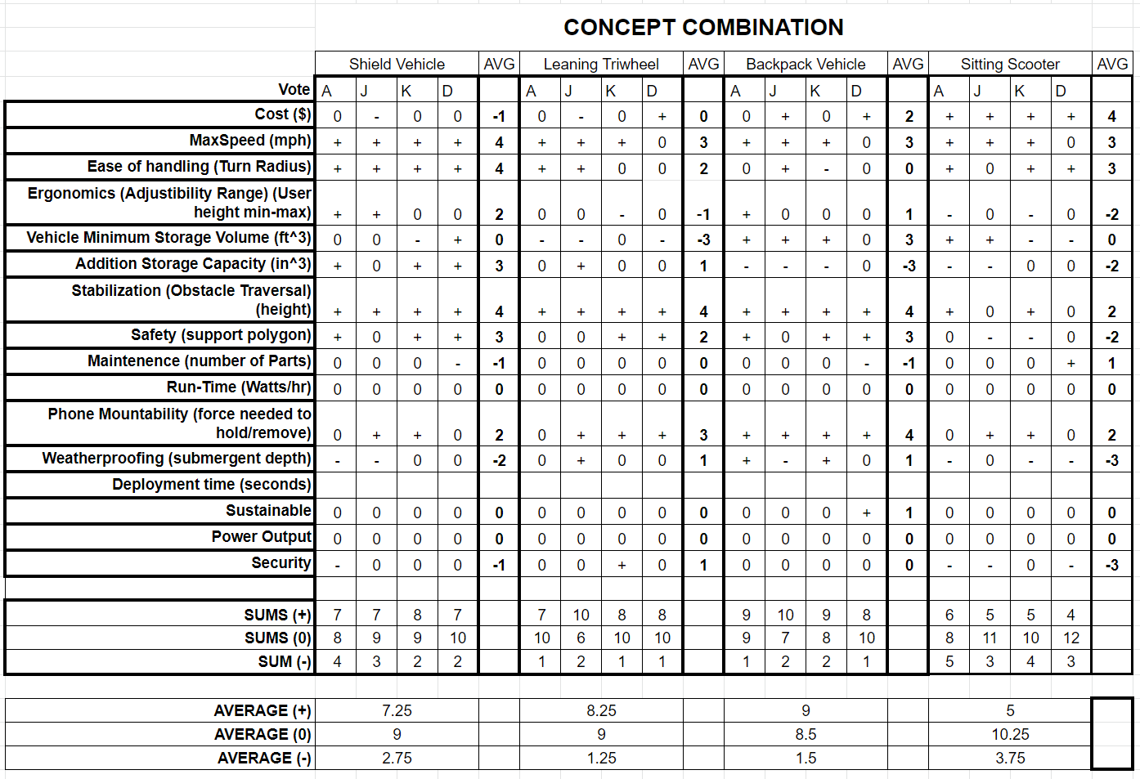
Stage 2

